Slide 1
Implementation and comparison of two cache prefetching schemes.
Computer Architecture (EEL5764) – Project
‘Prefetch on a Miss’ and ‘One Block Lookahead’
1/48

Slide 2
‘ForCache’ TEAM
AKASH THYAGARAJA – UFID : 41845521
ANUSHKA SWARUP – UFID : 84317011
MEDINI ARADHYA – UFID : 30181202
VARANASI NAGA VENKATA SAI – UFID: 10924981

Slide 3
INTRODUCTION
Objective: To implement two prefetching schemes namely Prefetch On a Miss and One Block Look Ahead and comparing the performance of both.
Tools: The Implementation and Simulation will be done on Simple Scalar.
Motivation : Recently, microprocessors have seen a considerable increase in speed but this trend has not been visible by memory access time. This has a counter effect on the microprocessors performance since they have to wait for multiple clock cycles for data from the memory. In an effort to solve this issue, cache memories have become very popular. Caches are prone to hit and miss rates. This issue can be mitigated by making use of prefetching mechanisms.

Slide 4
INTRODUCTION
The two Prefetching schemes we will be implanting are explained below: a) Prefetch on Miss – When there is a block ‘n’ missing from cache, this technique would fetch blocks ‘n’ & ’n+1’. Block ’n’ goes to cache and ‘n+1’ goes to stream buffer. b)OBL (One Block Lookahead) - When block ’n’ is accessed in cache; regardless of hit or miss block ’n+1’ is fetched.
We will be performing a comparative study of these two prefetching schemes implemented on Simple Scalar. Concluding with the performance of each individual scheme for various cases and analyze the performance in each case.

Slide 5
WORK DONE :
Successfully Implemented ‘Prefect on a miss’ and ‘One Block Lookahead’ scheme on Simple scalar.
Conducted preliminary analysis with following test benches: a) Anagram b) Test-Math c) Factorial
d) Test-llong
e) Test-lswlr
Resolved errors faced during the implementation of the cache prefetch schemes.
Result Evaluation and Report writing.

Slide 6
STREAM BUFFER
Prefetch Data
Stream Buffer 1
Prefetch Request
CPU
L1 Cache
Lower Level
Memory
Stream Buffer 2
Stream Buffer 3

Slide 7
METHODS/ IMPLEMENTATION
For implementing the two prefetching schemes, the source code was modified by adding appropriate data structures and pointers to simulate the stream buffer behaviour. The following pointers were added for this purpose:
item cp - cache pointer
item cs - cache set pointer
item buffer - stream buffer
Cache
Set
Block
Stream Buffer

Slide 8
PREFETCH ON A MISS
PREFETCH ON A MISS CACHE DESIGN:
(n+1)th block fetch
Stream Buffer
CPU (Sim-Cache)
L1 Cache
L2 Cache
nth block fetch
HW Prefetching Block Diagram – Prefetch on a miss

Slide 9
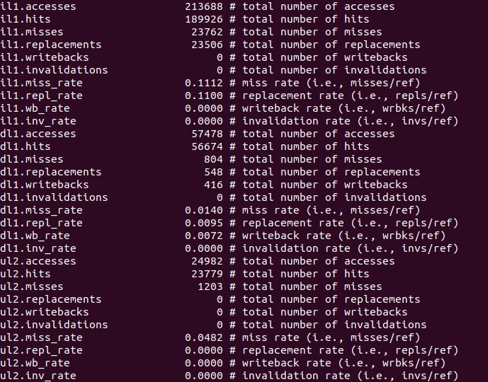
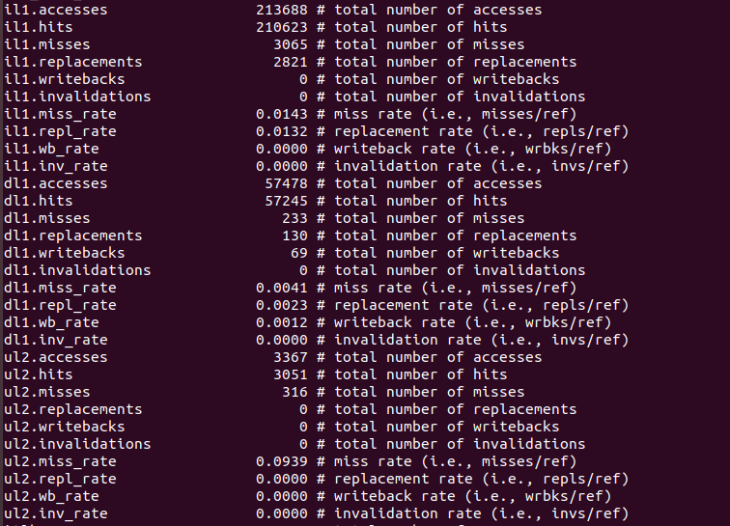
How results are observed.
Default cache
Cache with prefetch

Slide 10
ONE BLOCK LOOKAHEAD
One block lookahead is used to reduce the miss penalty and bus latency issues that are present while using the prefetch on a miss scheme.
One block lookahead differs from prefetch on a miss in terms that in this scheme the subsequent blocks are brought to the cache irrespective of whether it is a hit or a miss.
This scheme is more popular with respect to data access since they are more frequent than instructions.
BUT a potential drawback is that bringing in a block irrespective of a hit or miss could prove to be detrimental if the data accesses of the prefetched block is incorrect as it would wastefully occupy lot of space in the cache/streambuffer.

Slide 11
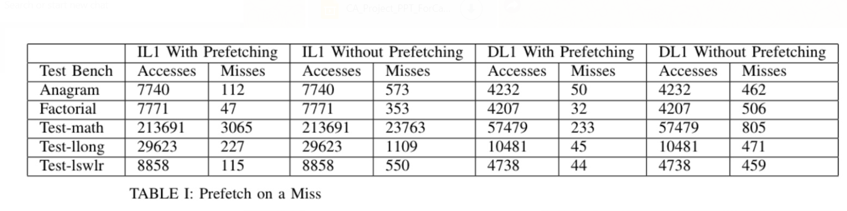
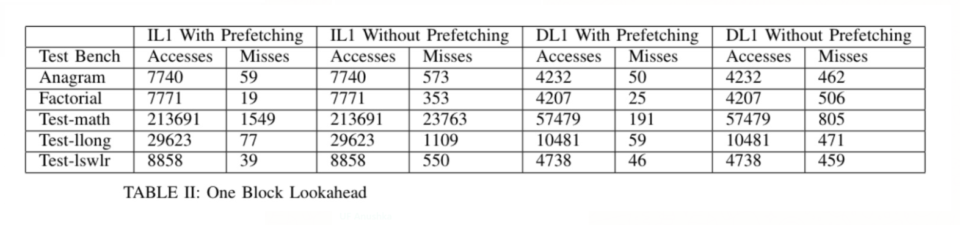
RESULT EVALUATION

Slide 12
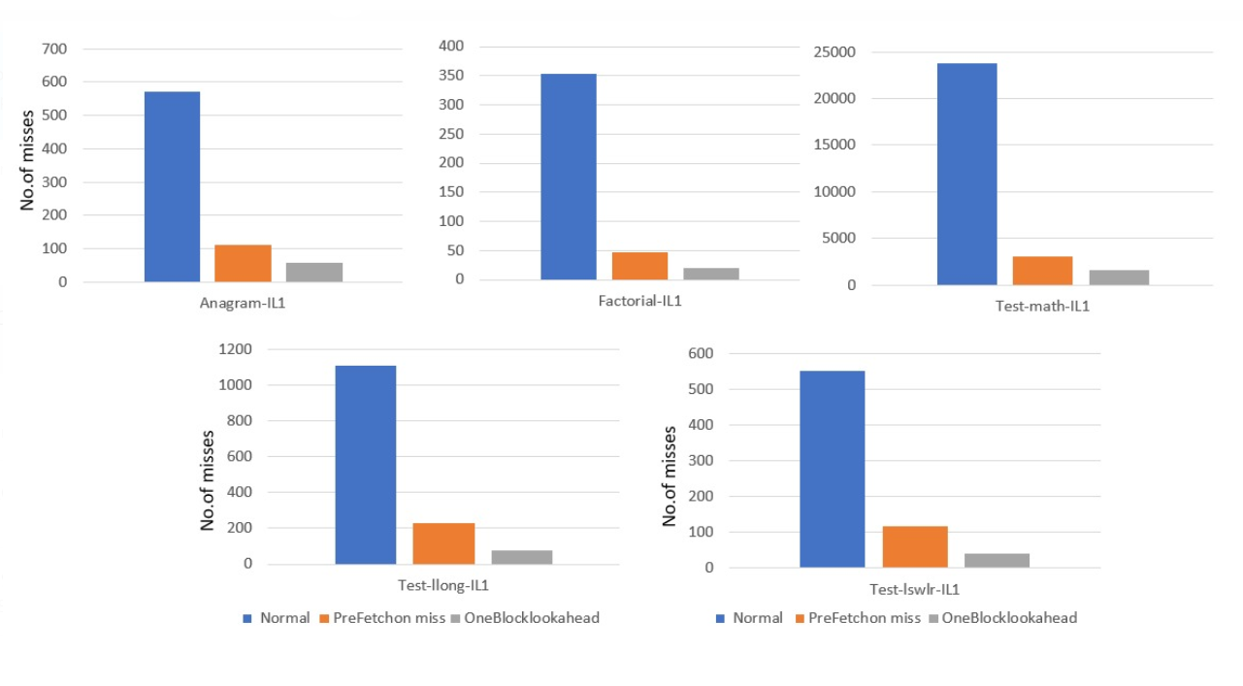
#of misses V/s Prefetching scheme for IL1

Slide 13
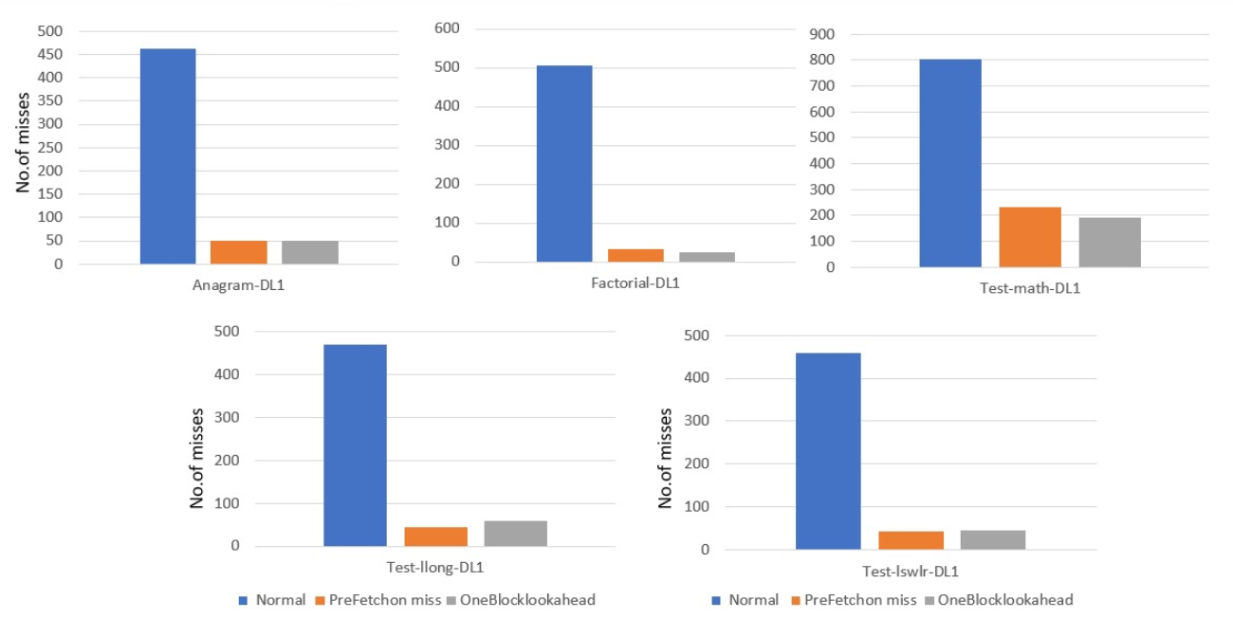
#of misses V/s Prefetching scheme for DL1

Slide 14
RESULT ANALYSIS & CONCLUSION
Miss rates are observed to be far lesser when we have implemented prefetching schemes.
OBL provides better performance in terms of reduction of miss rates as compared to Prefetch on a Miss.
We also observed that the performance was better visualized when we used the factorial test bench owing to its sequential nature of data.

Slide 15
PROBLEMS/ ROADBLOCKS
Conversion of external testbenches into a format compatible with Simplescalar.
Errors faced during compilation, related to Stream Buffer ( Proper Execution. How did we resolve it?
Used the little endian compiler
Deliberately created an error in cache.c file and then reran it.

Slide 16
48/48

